Slide 1

Individual age of death and related factors
Javier Corpus
March 1, 2025

Slide 2
Agenda
Introduction
Variables
Probability Mass Function (PMF)
Cumulative Distribution Function (CDF)
Normal Probability Plot
Scatter Plots
Hypothesis Tests
Regression Analysis
Conclusion

Slide 3
Introduction
In the realm of public health, understanding the factors that influence mortality is crucial for developing effective health information. The dataset used in this project provides a diverse number of variables, including age of death, weight, gender, smoker status, number of medications taken, number of drinks per week, and cholesterol level. By analyzing these factors, we can gain insights into how lifestyle choices and health metrics correlate with longevity. This analysis can help answering the following questions:
Is it more probable to have male smokers than female smokers at any given age?
Do male smokers have more drinks per week than female smokers?
Do male smokers die more frequently than non-smokers of the same age?
Do female smokers die more frequently than non-smokers of the same age?
Is weight related to the cholesterol level?
Is weight related to the number of drinks consumed?
Is it possible to predict the age of death based on smoking or drinking habits?
Assumption:
All the individuals in the dataset died of natural causes/diseases.

Slide 4
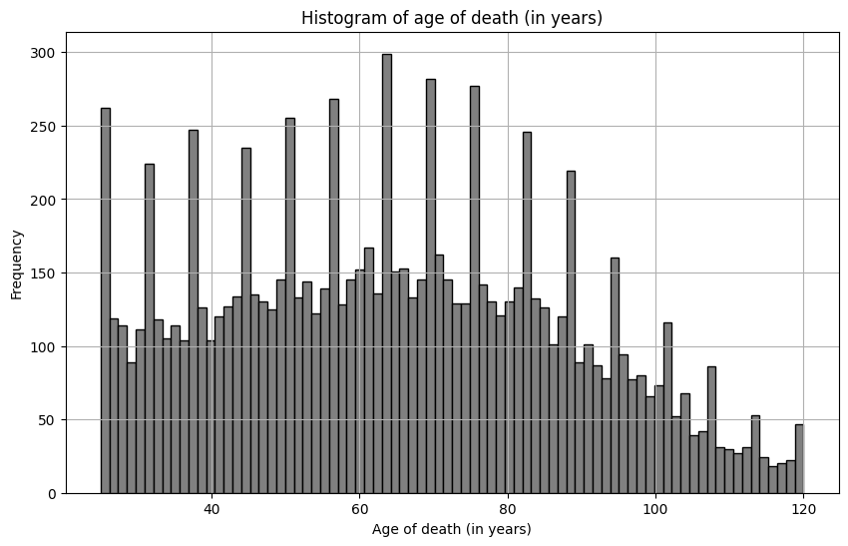
Variable: Age of Death
Variable Meaning:
Age (in years) when an individual
passed away.
Descriptive Characteristics:
Median: | 64
Mean: | 64.64
Spread: | 537.89
Skewness: | 0.19
Pearson’s Skewness: | 0.08
Analysis:
There are really no outliers, but there are
some interesting peaks all along the histogram.
There is a surprisingly high number of people
who died at a young age, and an even more
surprisingly number of people who lived after
100 years.

Slide 5
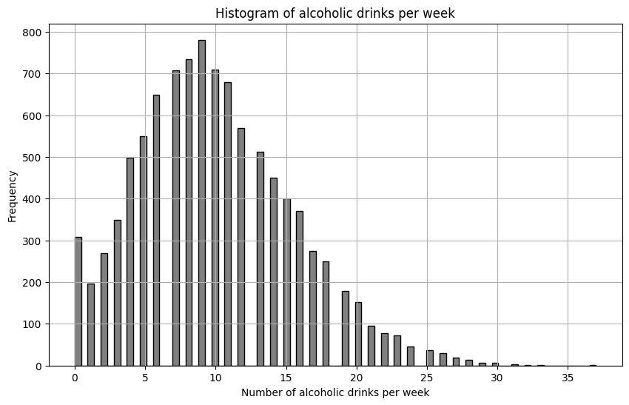
Variable: Alcoholic Drinks per Week
Variable Meaning:
Number of alcoholic drinks that the
individuals drank per week.
Descriptive Characteristics:
Median: | 9
Mean: | 9.98
Spread: | 30.87
Skewness: | 0.52
Pearson’s Skewness: | 0.53
Analysis:
There are a few outliers, people who had
more than 30 alcoholic beverages per
week. All these individuals died at a
young age.

Slide 6
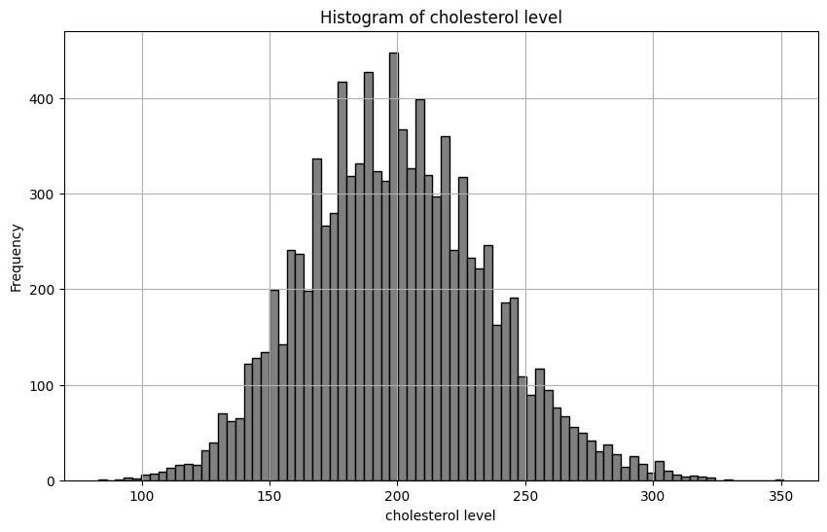
Variable: Cholesterol Level
Variable Meaning:
Level of cholesterol at the moment of
the individual’s death.
Descriptive Characteristics:
Median: | 199
Mean: | 199.74
Spread: | 1269.60
Skewness: | 0.24
Pearson’s Skewness: | 0.06
Analysis:
There are three outliers; individuals with a
cholesterol level above 320. These individuals
had between 12 and 32 alcoholic beverages
per week, and they had between 25 and 38
years when they passed away.

Slide 7
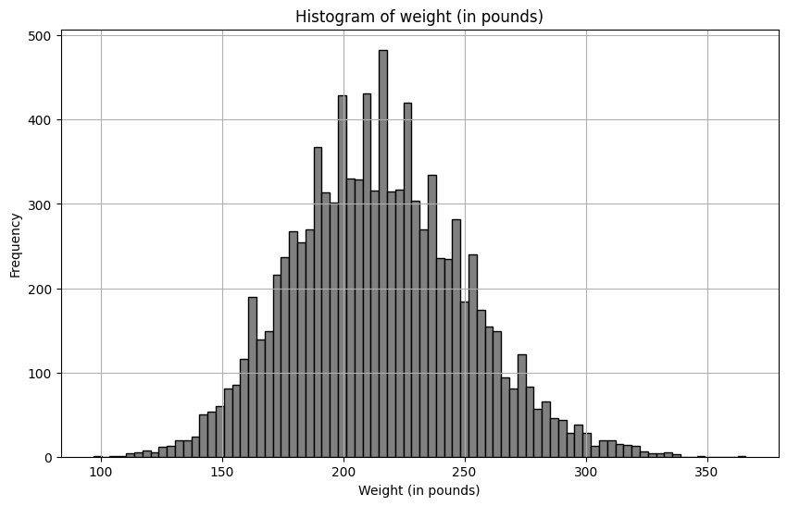
Variable: Weight
Variable Meaning:
Weight (in pounds) at the moment of
the individual’s death.
Descriptive Characteristics:
Median: | 214
Mean: | 214.73
Spread: | 1269.01
Skewness: | 0.24
Pearson’s Skewness: | 0.06
Analysis:
There are three outliers. One individual with
a weight of 97 pounds, and in the other
extreme two individuals with more than 346
pounds. The person with 97 pounds was a
female who died at 88 years. This histogram is
very similar with the cholesterol one.

Slide 8
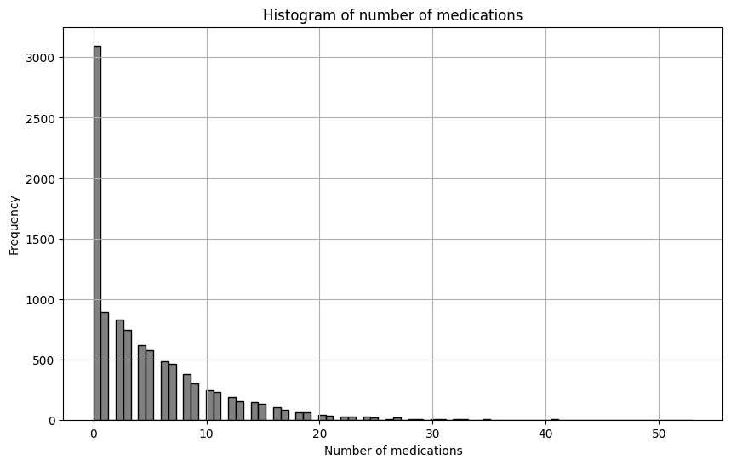
Variable: Medication
Variable Meaning:
Number of different medications the
individuals were taking.
Descriptive Characteristics:
Median: | 3
Mean: | 4.59
Spread: | 30.38
Skewness: | 1.73
Pearson’s Skewness: | 0.87
Analysis:
For this data, individuals taking more than
30 medications could be considered outliers.
The most extreme case is somebody taking 53
medications. It is surprising the number of
people not taking any medication at all.

Slide 9
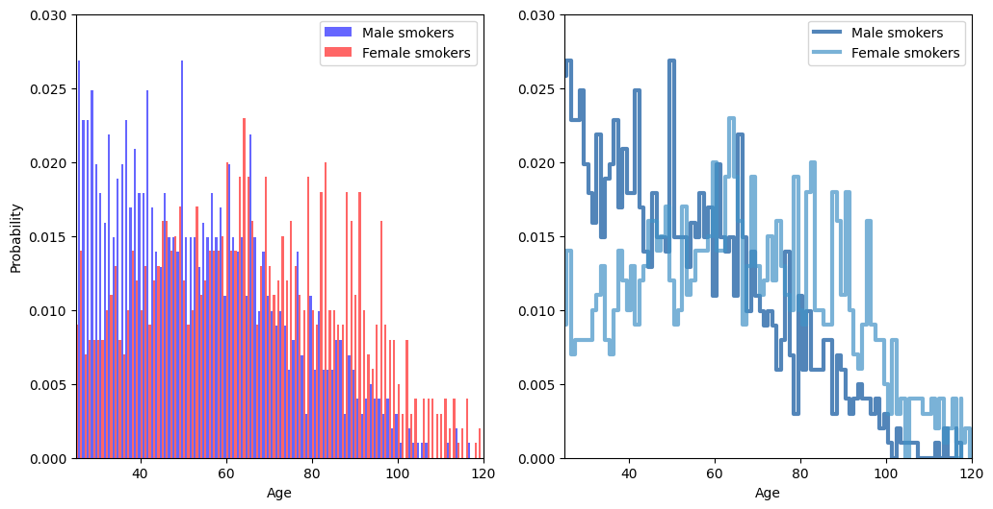
Probability Mass Function (PMF)
Analysis:
The PMF plot represents the age probability of both male and female smokers. It shows that for individuals under 40 years old, there is a greater possibility
for them to be males. Around 60 years old, both genders have a similar probability. Any smoker over the age of 100 is more likely to be a female.

Slide 10
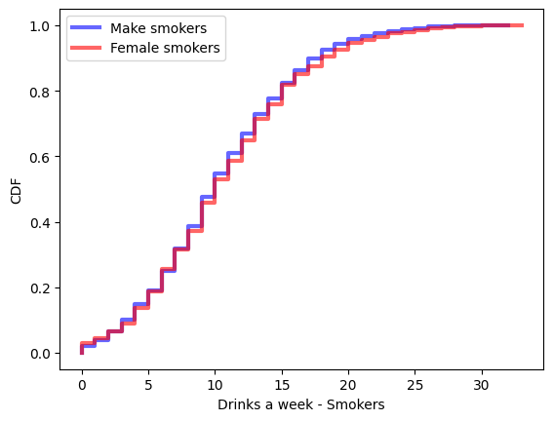
Cumulative Distribution Function (CDF)
Analysis:
This CDF plot represents the probability of the number of alcoholic drinks
a smoker had a week. The median is around 10 drinks. There is really no
significant difference between genders.
Of all the smokers in the dataset, 1,080 of them had 10 or less drinks per week,
while 926 individuals had more than 10.

Slide 11
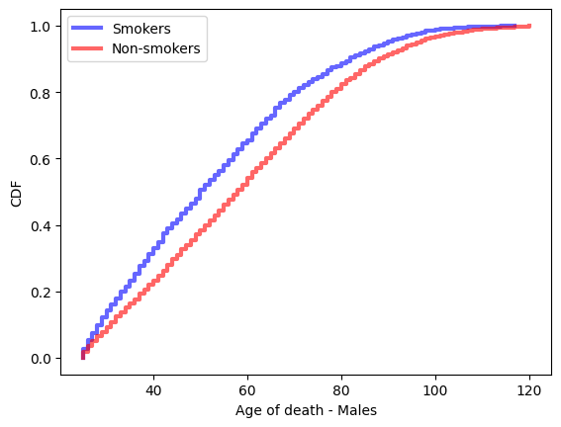
Cumulative Distribution Function (CDF)
Analysis:
This CDF plot represents the probability of the age of death for males, both
smokers and non-smokers.
Although it doesn’t appear to be a big difference, smokers have a higher
probability to die than non-smokers of the same age.

Slide 12
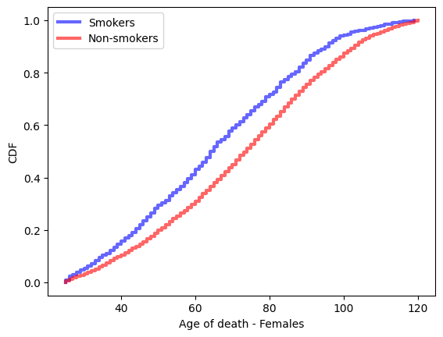
Cumulative Distribution Function (CDF)
Analysis:
This CDF plot represents the probability of the age of death for females, both
smokers and non-smokers.
Just like with the CDF plot for male smokes, it doesn’t appear to be a big
difference. However, smokers have a higher probability to die than non-smokers
of the same age.

Slide 13
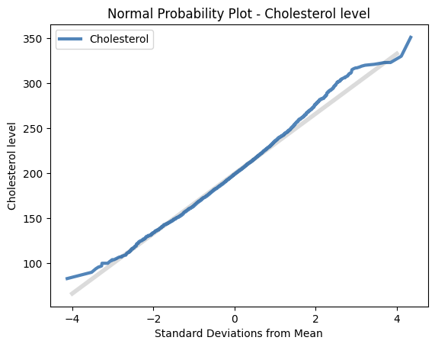
Normal Probability Plot
Analysis:
The Normal Probability Plot uses a reference line (“line of identity”). For this
particular example, most of the points follow the line, which means that the
cholesterol data is normally distributed.
This can also be observed in the histogram for the cholesterol levels.

Slide 14
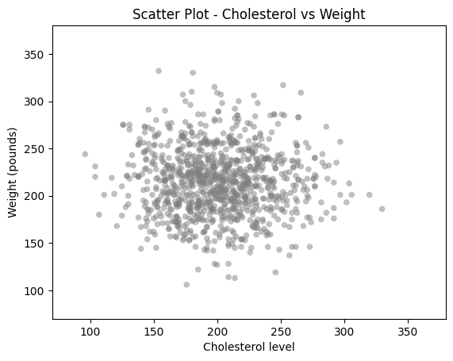
Scatter Plot
Analysis:
This plot suggest that there is little to no correlation between the weight and
the cholesterol level. Also, the wide dispersion between points suggest a
weak relationship between these variables.
There are a few outliers showing interesting combinations, like a medium
weight but high cholesterol level, or a relatively low cholesterol level, but
a higher number of pounds.
Correlations:
Covariance: | -87.94376
Correlation: | -0.06983804
Spearman’s Correlation: | -0.08751628

Slide 15
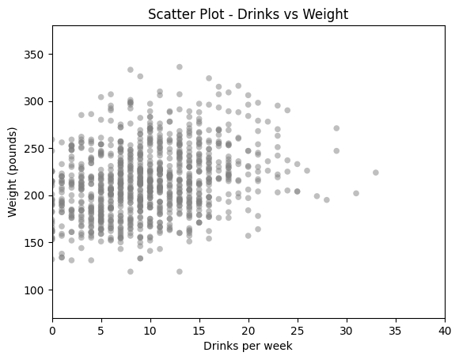
Scatter Plot
Analysis:
This plot suggest that there is little to no correlation between the weight and
the number of weekly alcoholic drinks. Also, the wide dispersion between points
suggest a weak relationship between these variables.
The outliers here also show interesting combinations, like a medium weight and
a high number of drinks.
Correlations:
Covariance: | 54.71622
Correlation: | 0.268488
Spearman’s Correlation: | 0.258907

Slide 16
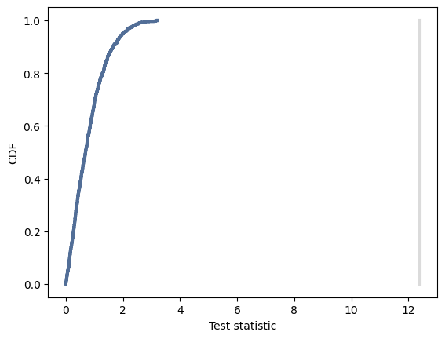
Hypothesis Test
Analysis:
Using age of the male and female smokers, the p-value is 0.0.
This means that the observed data is extremely unlikely under the
null hypothesis.

Slide 17
Regression Analysis
OLS Regression Results
Dep. Variable: | age | R-squared: | 0.200
Model: | OLS | Adj. R-squared: | 0.200
Method: | Least Squares | F-statistic: | 1251
Date: | Tue, 25 Feb 2025 | Prob (F-statistic): | 0.00
Time: | 20:19:51 | Log-Likelihood: | -44511
No. Observations: | 10000 | AIC: | 8.903e+04
Df Residuals: | 9997 | BIC: | 8.905e+04
Df Model: | 2
Covariance Type: | nonrobust
Analysis:
The R-squared value of 0.2 is too low, which indicates a very weak relationship between age of
death and the number of drinks per week, and
whether or not an individual was a smoker.
Using only these variables it is very difficult to predict the age of death of a person.
 | coef | std err | t | P>|t| | [0.025 | 0.975]
Intercept | 83.7736 | 0.435 | 192.484 | 0.000 | 82.920 | 84.627
smoker[T.y] | -5.5675 | 0.519 | -10.735 | 0.000 | -6.584 | -4.551
drinks_aweek | -1.8051 | 0.037 | -48.294 | 0.000 | -1.878 | -1.732
Omnibus: | 226.057 | Durbin-Watson: | 1.988
Prob(Omnibus): | 0.000 | Jarque-Bera (JB): | 129.549
Skew: | 0.107 | Prob(JB): | 7.39e-29
Kurtosis: | 2.485 | Cond. No. | 29.7

Slide 18
Conclusion
The data shows that smokers that die young are more likely to be males, and they have approximately the same number of drinks per week, regardless of the gender.
It is more probable for a smoker to die than a non-smoker of the same age, although the difference is minimal according to the data. This is true for both genders.
Cholesterol level and the number of drinks per week is not strongly related to weight.
Unfortunately, the data used here is not enough to predict the age of age with great accuracy. There are many factors that influence an individual’s health, like exercise, food habits, and family health history, among others. That information is missing from the dataset.

Slide 19
References
Dataset:
Joann Pineda (2025, February 3). “Individual Age of Death and Related Factors”. Kaggle.com. Retrieved on February 3, 2025 from https://www.kaggle.com/datasets/joannpineda/individual-age-of-death-and-related-factors

